Slide 1
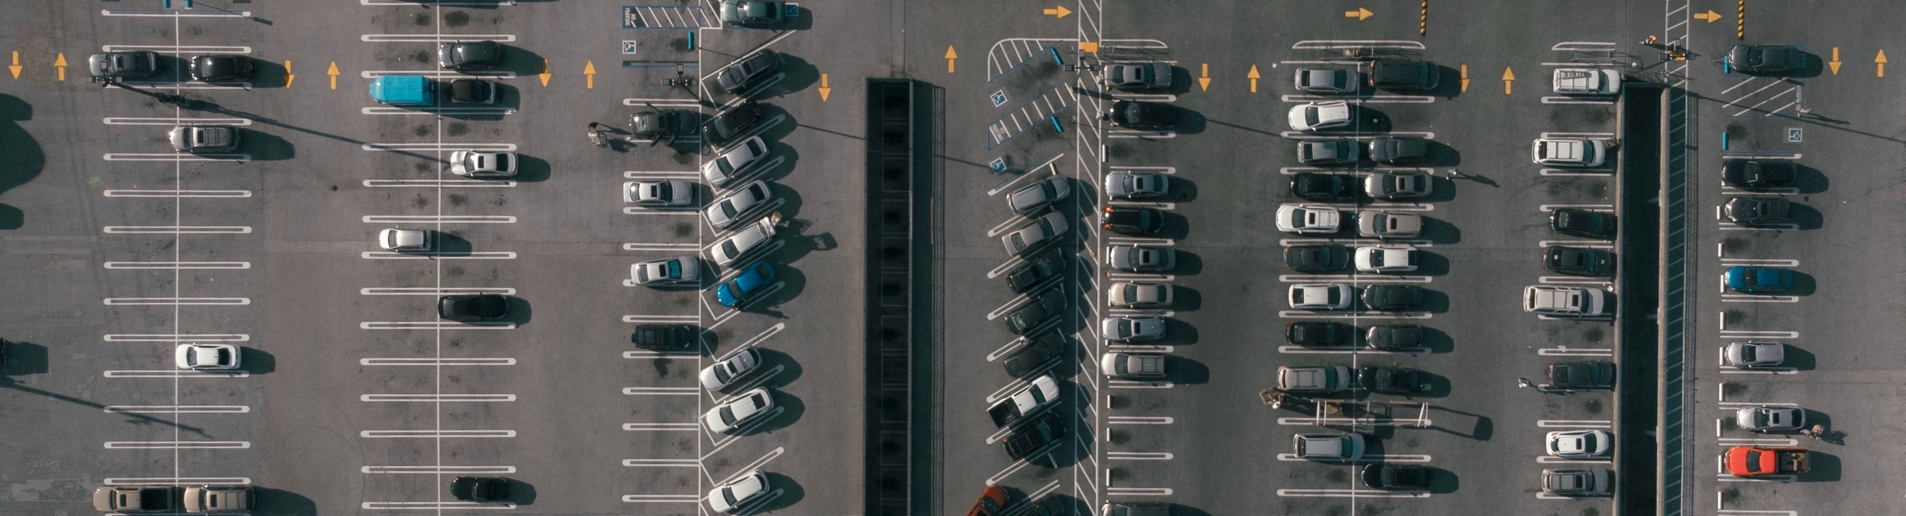
Spot or Not?
Parking Spot Vacancy with Machine Learning
Jeffrey Jex
Final Capstone Project

Slide 2
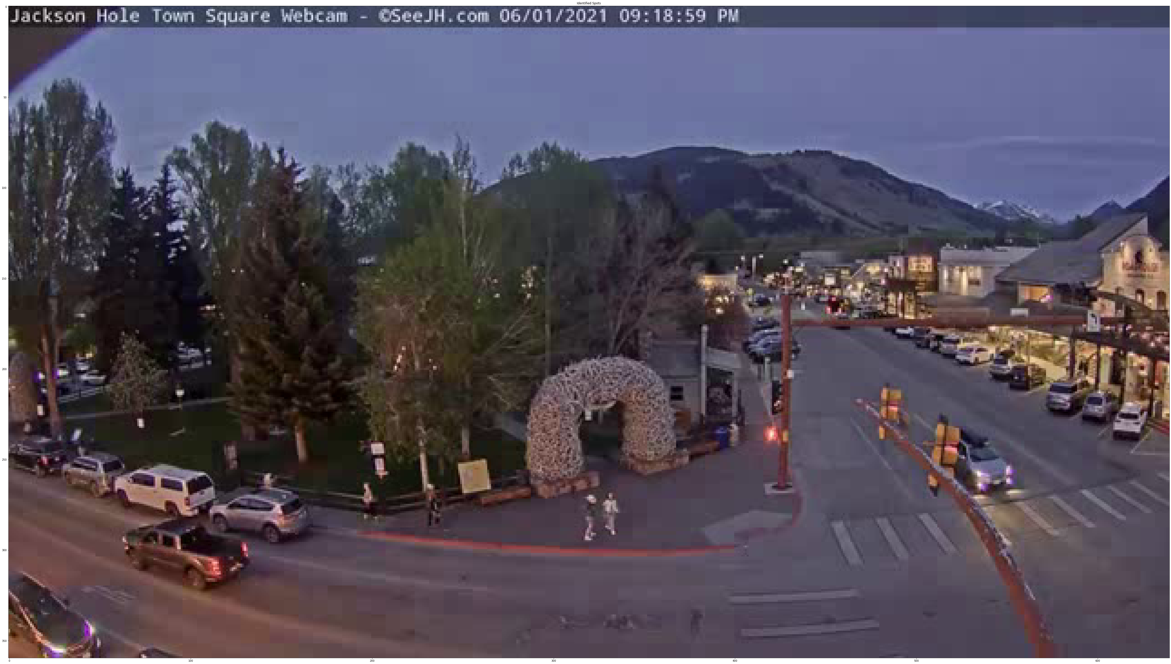
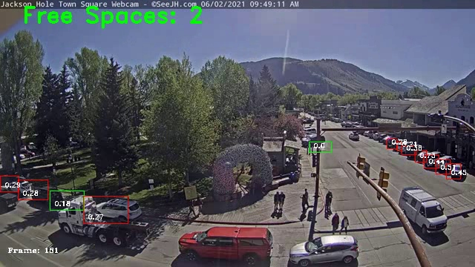
Problem
Objective
It's hard to find a parking spot in a busy place. Are there open spots right now? How many? When is it not busy?
It’s 2021, there’s data for that.
Identify vacant spots with live webcam data using machine learning. Specifically, the Jackson Hole Town Square camera.

Slide 3
Use Cases
Find out if a parking lot is busy before visiting.
Vehicle routing - send vehicles to open spots via navigation app or digital signage.
Proxy for number of customers visiting a business over time.
Proxy for how busy an area is - for example: shopping malls, airports, conference centers.
Identify under utilized portions of parking lots to flag for repurposing.
Identify commonly used 'parking spots' that aren't allowed (parking illegally).

Slide 4
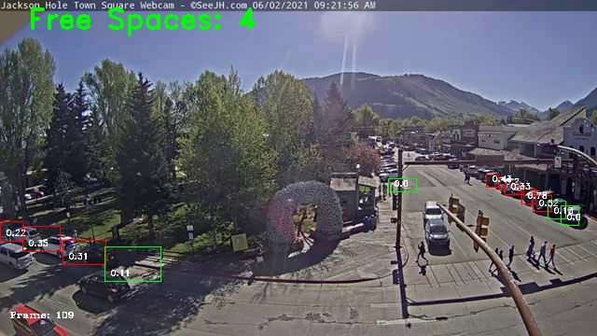

Continual learning Potential
Potential for continual feedback from app users to improve model
We’re still learning. Please click any incorrectly labeled spaces to help us improve.
Done

Slide 5
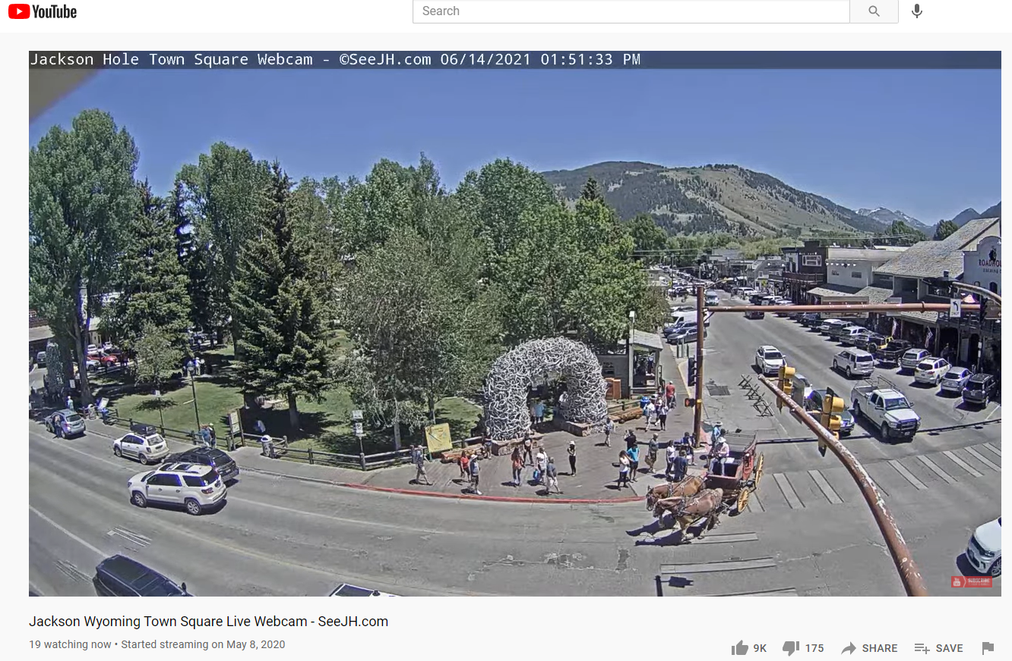
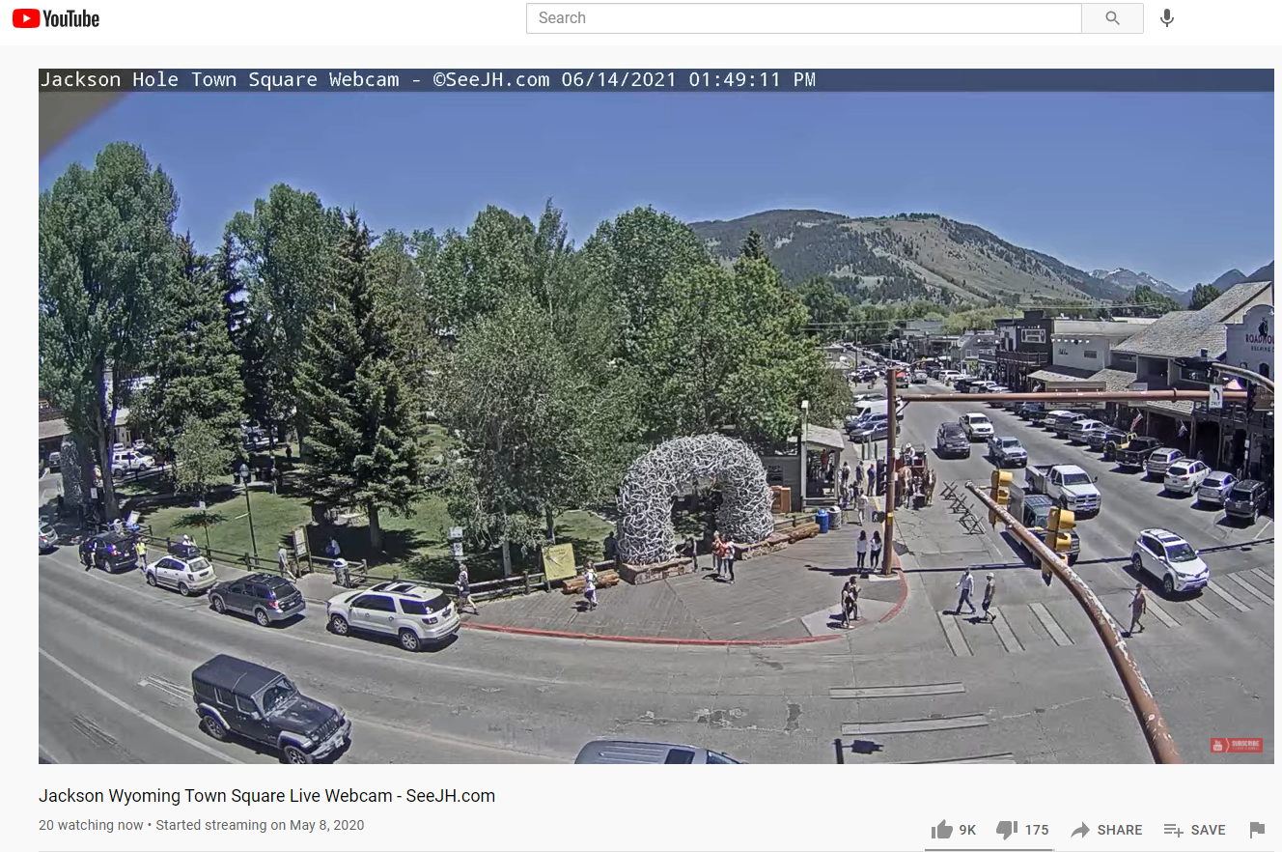
Data used
Notes:
https://www.youtube.com/watch?v=DoUOrTJbIu4

Slide 6
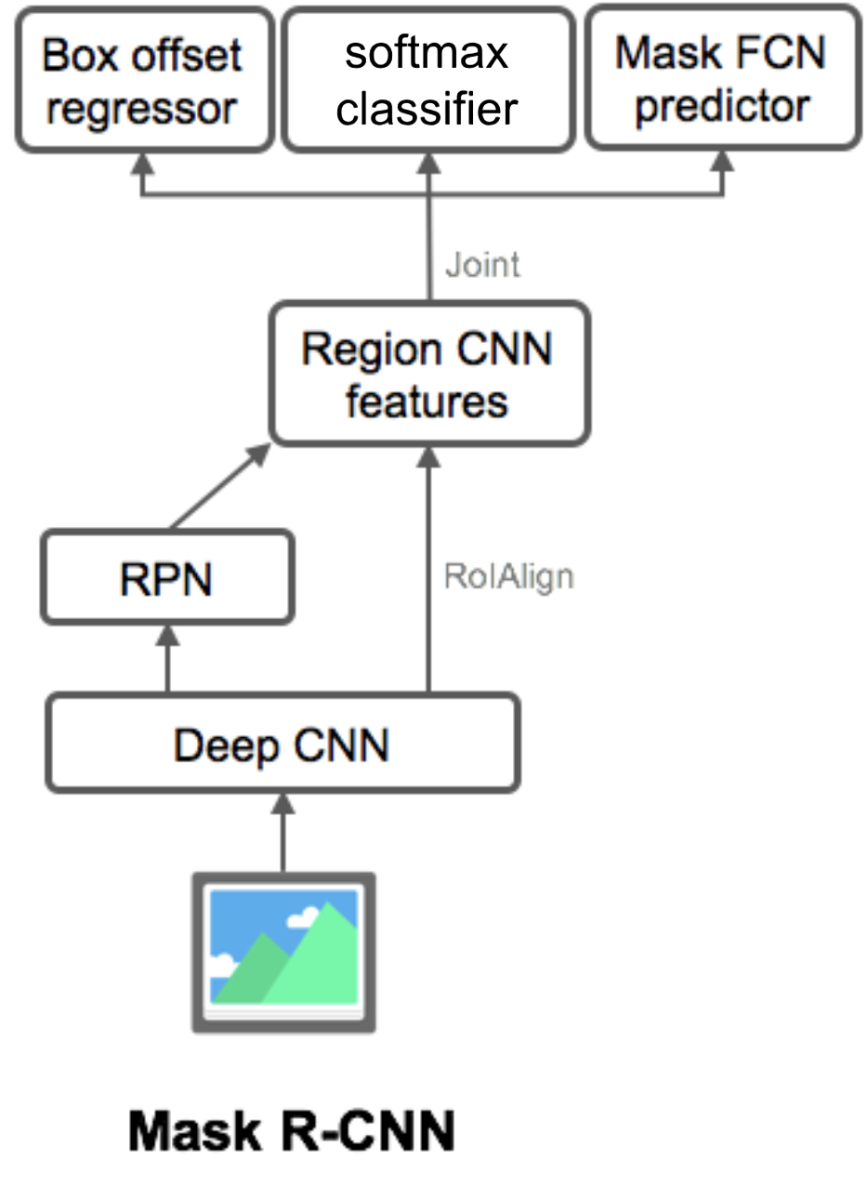
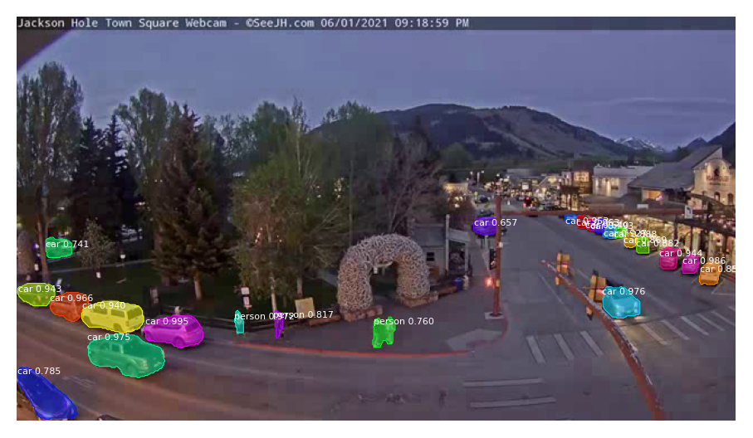
Mask R-CNN overview
(not currently used in this app)
Results:
Bounding box
Classification
Image mask
Mask R-CNN (Region-Convolutional Neural Network)
Youngest member of the R-CNN family
Updated version that works with TensorFlow 2
Matterport model weights, pretrained on the COCOs dataset.
Initial image:
Figure after Weng, Lilian, 2017. Object Detection for Dummies Part 3: R-CNN Family.
Notes:
Convolutional neural network based deep learning model
Segments image into bounding boxes (instance segmentation)
classifies image in bounding boxes (dog, cat, car?)
Creates a pixel-level mask

Slide 7
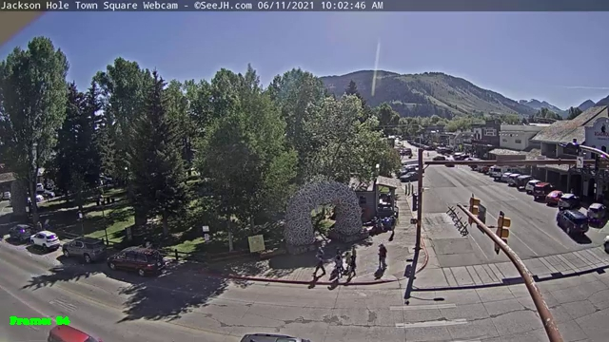
Method
Frame A – Capture all car bounding boxes
Step 1: Identify parking spots
Intuition: If I see a car that doesn’t move between frame A and B, it must be a parked car! Save it’s location as a ‘parking spot’.
Frame A: Detect all the cars in the image. Save their bounding boxes for later.

Slide 8
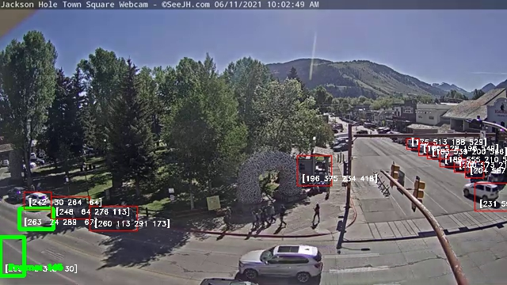
Method
Frame B – Keep only boxes that are still occupied
Step 1: Identify parking spots
Frame B: Detect all cars in the new image.
Check all the boundary boxes from frame A – do they have a car in them in frame B? If they do, consider it a parking space.
If they don’t, throw that box away, it was just a passing car.
Errors:
Misclassification (that’s not a car!)
Parking spot in the road – if a car happened to be in the same spot on both frames, this simple check will think that was a parking spot.
Misclassification
Different cars,
same spot
Red box: identified parking spot
Green box: not a spot (car location on frame A but not frame B)

Slide 9
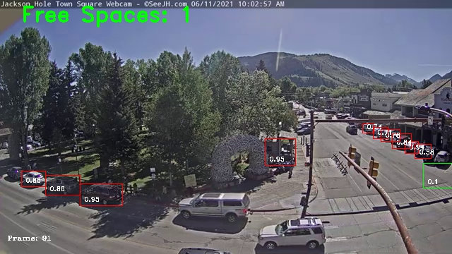
Method
Step 2: Determine if spots are full
Based on IoU overlap between saved parking spot box and cars detected in frame.
Repeat on every frame, comparing with boxes found in step 1.
Red box: Filled spot
Green box: Vacant spot

Slide 10
Streamlit app Demo
https://share.streamlit.io/rejexx/parkingspot_vacancy/main/src/streamlit_app.py

Slide 11
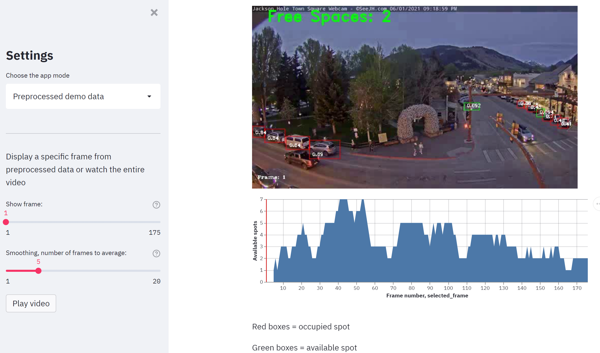
Preprocessed data
Notes:
In lie of demo

Slide 12
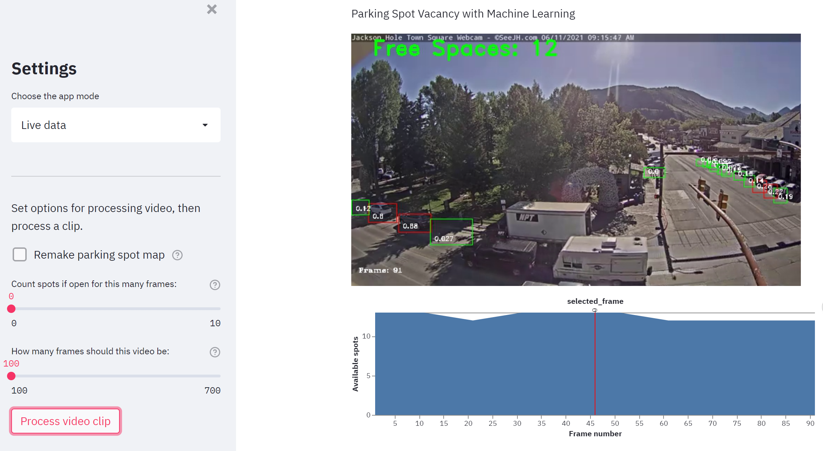
Live data
Notes:
In lie of demo

Slide 13
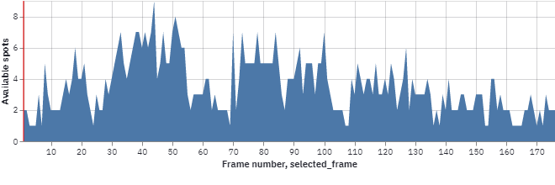
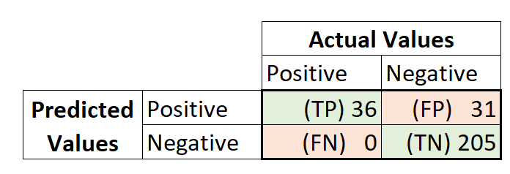
Results
Human vs. algorithm metrics for every 10th frame of 170 frames
Mean Avg Precision | 0.57
Sensitivity (recall) | 0.15
Specificity | 0.87
Misclassification | 0.11
Positive: Vacant spot
Negative: Filled spot
Notes:
Accuracy – not included because this imbalanced data set would look too good – misleading.
Sensitivity – tells how imbalanced the data set is (perfect balanced = 0.5)
Specificity – Indicates very few FPs
Common false positive causes and potential solutions:
Parking spots that are very few pixels (in the back) were frequently misclassified. Use higher resolution video stream or ignore those spots. This could bring accuracy as high as 0.96 (!).
Black or white cars were often misclassified. Higher resolution, or more specific model training to identify those types of cars would probably help.
Temporary occlusion of spaces (such as a garbage truck or bus driving in front of them) caused the model to think spaces were 'available' because the space was blocked by something it didn't recognize as a car. This could be fixed by waiting a few extra frames before declaring a spot as 'vacant' to make sure its really vacant. This code is already implemented in the 'live demo' version, but wasn't used on this set to make it clear exactly what the algorithm is doing.

Slide 14
Future Work
Algorithm and Statistics
Use a higher resolution stream to capture cars farther from the camera, and add in blurring faces of pedestrians (for privacy).
Implement YOLO algorithm, which is faster but less accurate than R-CNN.
More samples on model accuracy vs. human counting open/filled spots.
Try cnrpark's training images for open/vacant parking spots and see if it performs better than car detection with IOU (Amato, 2021).
Currently struggles with black cars or trucks, try re-training the model, or using higher resolution stream to resolve this.
App Features
Ability to replay processed video
Add options to run on any video:
Enter your own video URL or upload one
Download parking place bounding boxes after processing
Upload saved parking place bounding boxes for next time
Download processed video and vacancy data
Store 'parking lot vacancy' data to glean insights about parking lot.

Slide 15
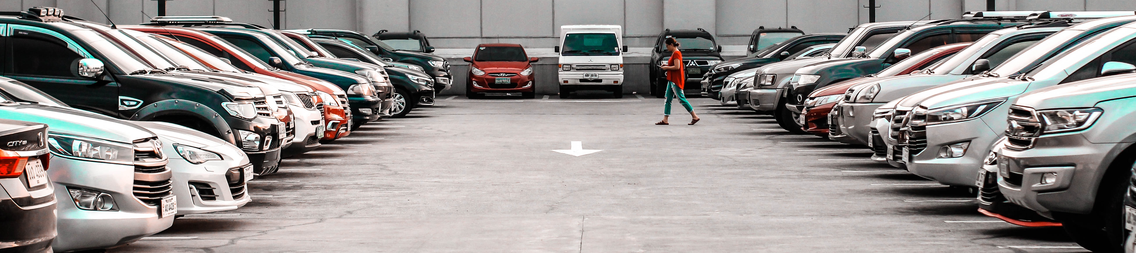
Conclusions
Identified vacant spots on Jackson Hole Town Square camera using Mask R-CNN.
Deployed Streamlit app pulls a live YouTube clip and runs detection in real time.
High potential to boost precision (currently 0.57) with minor changes.

Slide 16
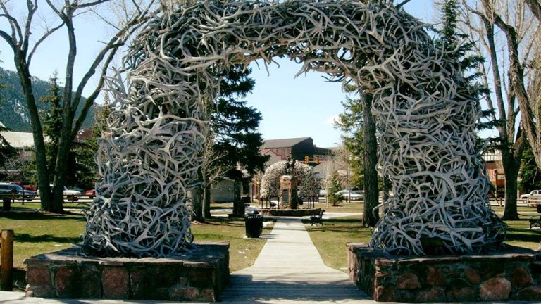
Thank you!
Asenath Jex – endless support, patience, and the gift of time.
VisitJacksonHole.com - for allowing use of their webcam.
Mukesh Mithrakumar – my awesome Springboard mentor.
Open Source packages– the backbone of the data science world. Thanks to everyone who contributes.
Jackson Hole’s antler arch has more than 2,000 antlers

